Slide 1

Algebra 1
Unit 6, Lesson 3 Writing and Solving Inequalities Volume 1, pg. 304

Slide 2


Benchmark
MA.912.AR.2.6
Given a mathematical or real-world context, write and solve one-variable linear inequalities, including compound inequalities. Represent solutions algebraically or graphically.
volume 1, pg. 304

Slide 3
Integrated Mathematical Thinking and Reasoning Standards
MA.K12.MTR.1.1 Actively participate in effortful learning both individually and collectively.
MA.K12.MTR.2.1 Demonstrate understanding by representing problems in multiple ways.
MA.K12.MTR.3.1 Complete tasks with mathematical fluency.
MA.K12.MTR.4.1 Engage in discussions that reflect on the mathematical thinking of self and others.
MA.K12.MTR.5.1 Use patterns and structure to help understand and connect mathematical concepts.
MA.K12.MTR.6.1 Assess the reasonableness of solutions.
MA.K12.MTR.7.1 Apply mathematics to real-world contexts.
volume 1, pg. 304

Slide 4

Learning Targets
I can write and solve a two-step, one-variable inequality.
I can write and solve a multi-step, one-variable inequality.
I can write and solve a compound one-variable inequality.
I can interpret solutions to problems as viable or non-viable options.
volume 1, pg. 304

Slide 5

Warm-Up
volume 1, pg. 305

Slide 6
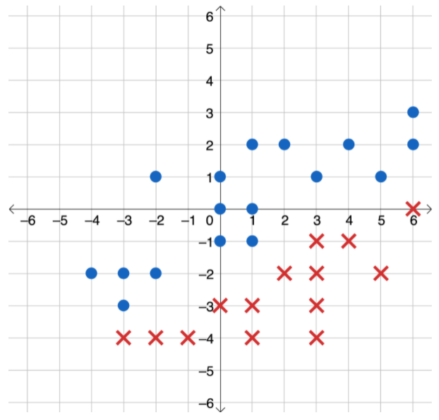
6.3.1 Warm-Up: Notice and Wonder
Draw a line that separates the circles and the Xs on the coordinate grid shown.
volume 1, pg. 305

Slide 7
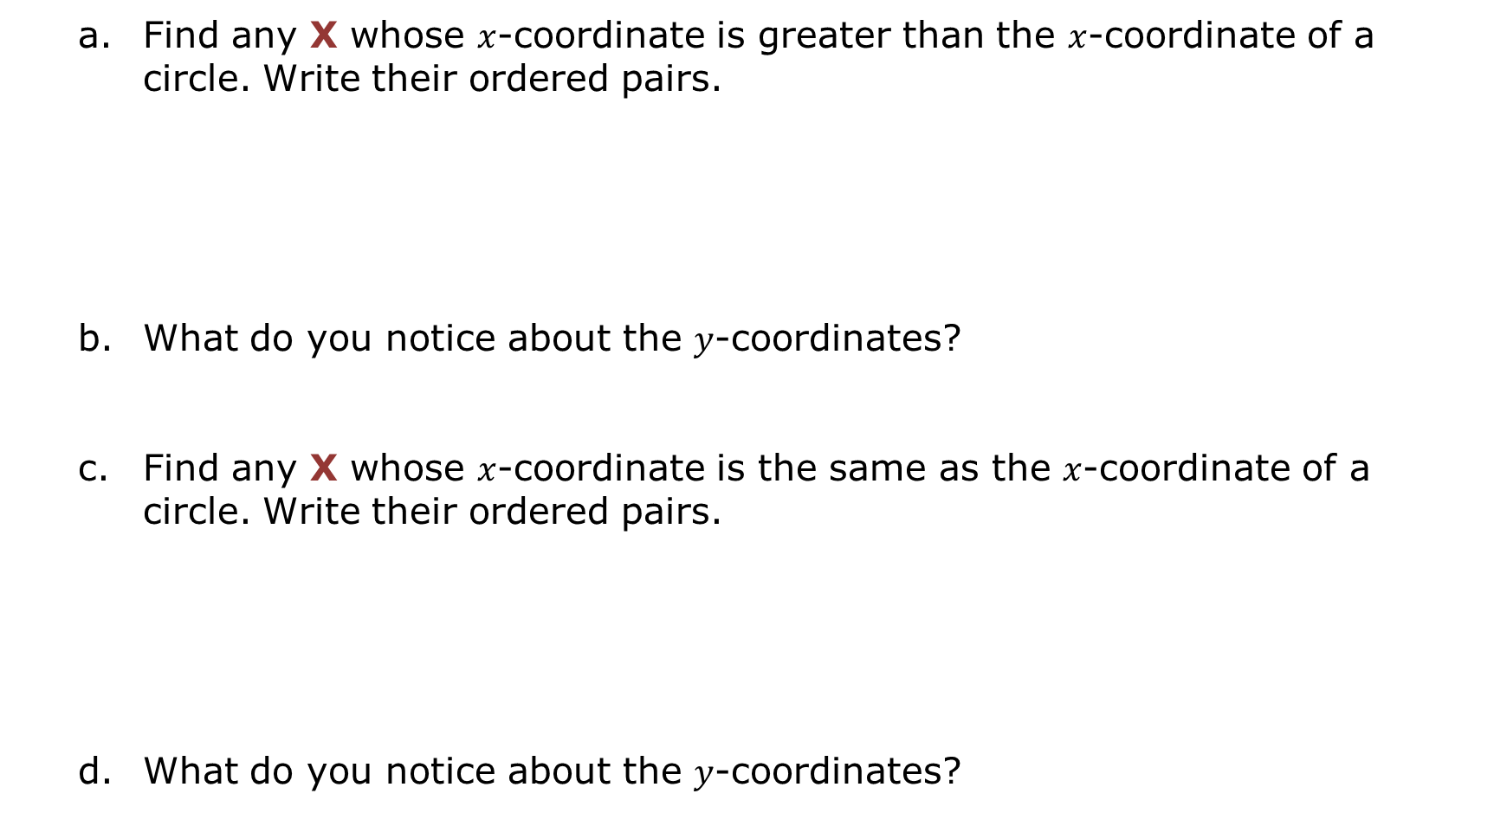
Find any X whose $x$-coordinate is greater than the $x$-coordinate of a circle. Write their ordered pairs.
What do you notice about the $y$-coordinates?
Find any X whose $x$-coordinate is the same as the $x$-coordinate of a circle. Write their ordered pairs.
What do you notice about the $y$-coordinates?
X | ●
X | ●
volume 1, pg. 305

Slide 8

Collaboration
volume 1, pg. 305

Slide 9

6.3.2 Collaboration: Inequalities in Real-World Contexts
Work with your partner to complete the following.
Three inequalities are given. Match each of the inequalities to one of the situations below. Then, solve the inequality and explain how it matches the situation.
$$5h+4.5≤20$$ | $$4.5≤5k≤20$$ | $$5m>20+4.5m$$
volume 1, pg. 305

Slide 10
Situation A
Markus went to his local coffee shop to get a latte and some coffee beans. The latte cost $4.50 and beans cost $5 per pound. He has a $20 bill and wants to know how many pounds of beans he can buy.
Matching Inequality and Solution | How does the inequality match the situation?
volume 1, pg. 305

Slide 11
Situation B
At Rolling Lanes Bowling Alley, the cost is $5 per game for non-members and $4.50 per game for members. There is a $20 annual fee to be a member. Luna wants to know how many games she needs to play in a year in order for the membership to be a good deal.
Matching Inequality and Solution | How does the inequality match the situation?
volume 1, pg. 306

Slide 12
Situation C
Ihab is training for a marathon. He runs at a pace of 5 miles per hour (mph). In the past week, the distances of his runs have ranged from 4.5 miles to 20 miles. He writes an inequality that can be used to find the range of time he’s spent running in the past week.
Matching Inequality and Solution | How does the inequality match the situation?
volume 1, pg. 306

Slide 13

Exploration
volume 1, pg. 306

Slide 14

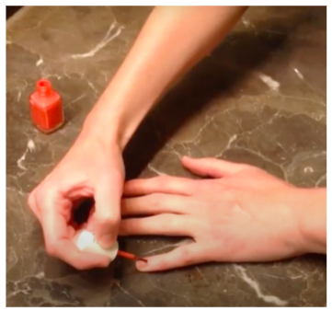
6.3.3 Exploration: Is There Enough Time?
Candace is getting ready to leave for the movies. She decides at the last minute to try to paint her nails before she leaves. It’s 6:40 p.m., and Candace needs to leave at 7:00 p.m. What information do you need to determine if she will have enough time to paint her nails?
volume 1, pg. 306

Slide 15
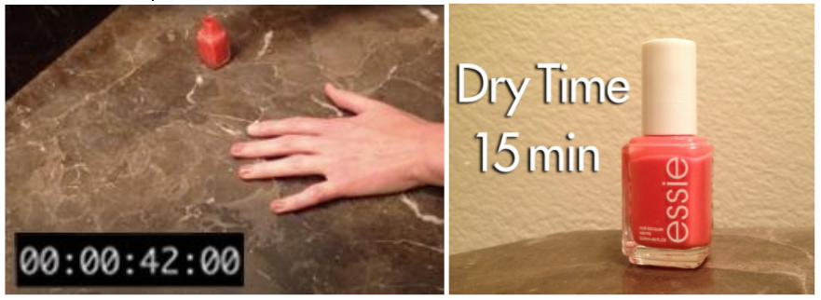
The images shown give additional information about the situation. The first image shows it takes her 42 seconds to paint the first three nails. The second image gives the amount of time she needs to let her nails dry before leaving.
How long does it take her to paint each nail, on average?
Explain whether or not you think Candace will have enough time to paint her nails.
volume 1, pg. 307

Slide 16

Guided Instruction
volume 1, pg. 307

Slide 17
6.3.4 Guided Instruction: Writing Inequalities to Represent Real-World Contexts
The nail polish scenario provides an example of how inequalities can be used to solve problems in the real world.
Let t be the time it takes to paint one nail, in minutes. Write an expression in terms of t that represents the total amount of time it takes for the nail polish process to be complete, including 15 minutes for drying.
In the Exploration, Candace had a maximum of 20 minutes. Using your expression from Part A, write an inequality that represents this situation.
volume 1, pg. 307

Slide 18
Solve the inequality.
Explain how the maximum value in the solution set relates to the nail polish situation.
Graph the solution set.
volume 1, pg. 307

Slide 19

The value $−0.5$ is in the solution set of the inequality. Discuss with your partner why this is not a viable solution in the real-world context. Write your explanation.
Explain whether or not the value 0 is a viable solution in this context.
volume 1, pg. 308

Slide 20
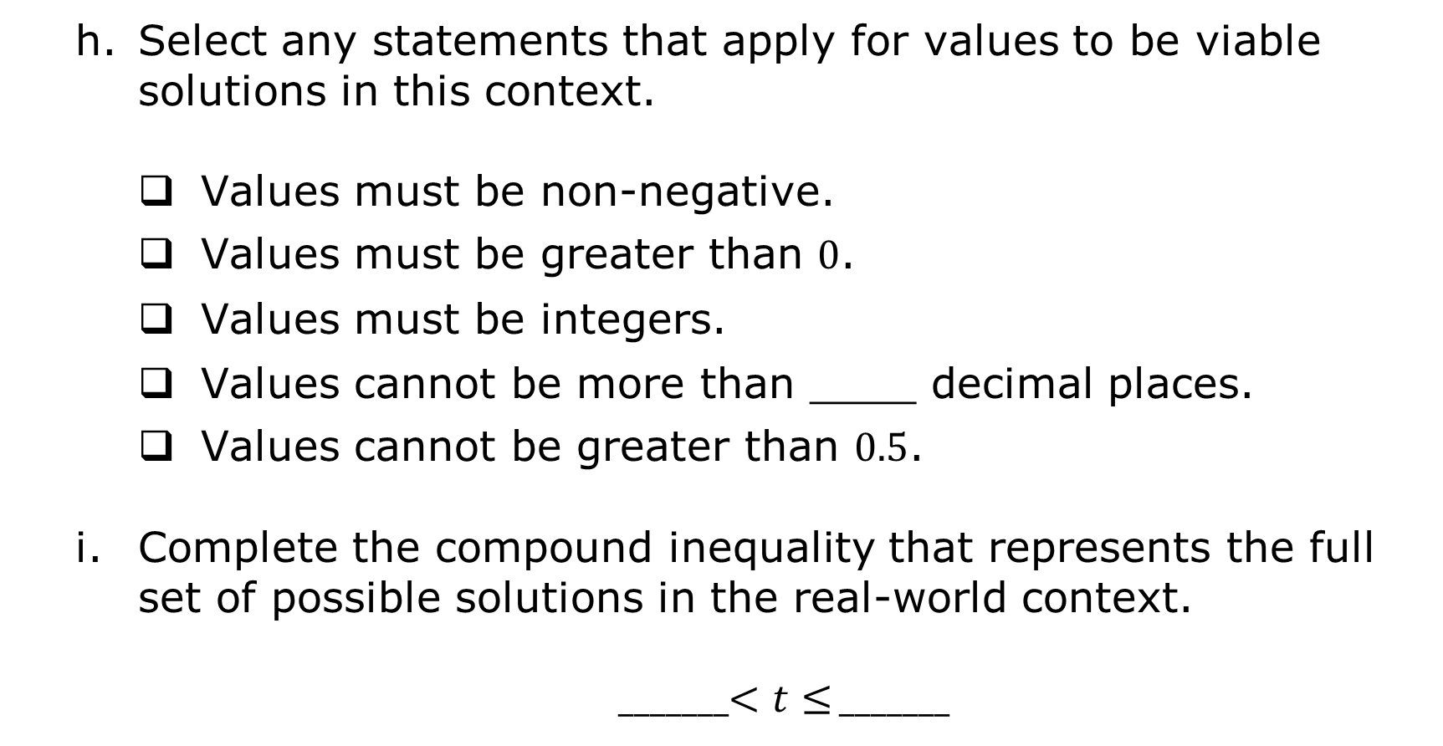
Select any statements that apply for values to be viable solutions in this context.
Values must be non-negative.
Values must be greater than 0.
Values must be integers.
Values cannot be more than ____ decimal places.
Values cannot be greater than 0.5.
Complete the compound inequality that represents the full set of possible solutions in the real-world context.
_______$<t≤$ _______
volume 1, pg. 308

Slide 21

Activity
volume 1, pg. 308

Slide 22

6.3.5 Activity: Gallery Walk
Work with your partner or small group to complete the following for each real-world context.
Write an inequality to represent the situation, including defining the variable used.
Solve the inequality and graph the solution.
Identify and explain any non-viable solutions.
volume 1, pg. 308

Slide 23
Context A – Vacation Savings
Inequality
Solution
Graph
Non-Viable Solutions in the Set | Check any that apply. Solutions must be non-negative Solutions must be integers Explain.
volume 1, pg. 308

Slide 24
Context B – Non-Operating Temperatures
Inequality
Solution
Graph
Non-Viable Solutions in the Set | Check any that apply. Solutions must be non-negative Solutions must be integers Explain.
volume 1, pg. 309

Slide 25
Context C – Gym Memberships
Inequality
Solution
Graph
Non-Viable Solutions in the Set | Check any that apply. Solutions must be non-negative Solutions must be integers Explain.
volume 1, pg. 309

Slide 26
Context D – Planting Citrus Trees
Inequality
Solution
Graph
Non-Viable Solutions in the Set | Check any that apply. Solutions must be non-negative Solutions must be integers Explain.
volume 1, pg. 310

Slide 27

Wrap-Up
volume 1, pg. 310

Slide 28
6.3.6 Wrap-Up: Reflection
Which mindset did I demonstrate? | Choose the best description.
Did I use the partner discussions as learning opportunities? | Never Sometimes Usually Always
Did I work on problems that challenged me? | Never Sometimes Usually Always
Did I use strategies to “un-stick” myself when I found the problems difficult? | Never Sometimes Usually Always
volume 1, pg. 310

Slide 29
Which mindset did I demonstrate? | Choose the best description.
Did I re-read the problem to ensure understanding of the context? | Never Sometimes Usually Always
Did I put as much effort as I possibly could into the problems? | Never Sometimes Usually Always
volume 1, pg. 310

